Slide 1
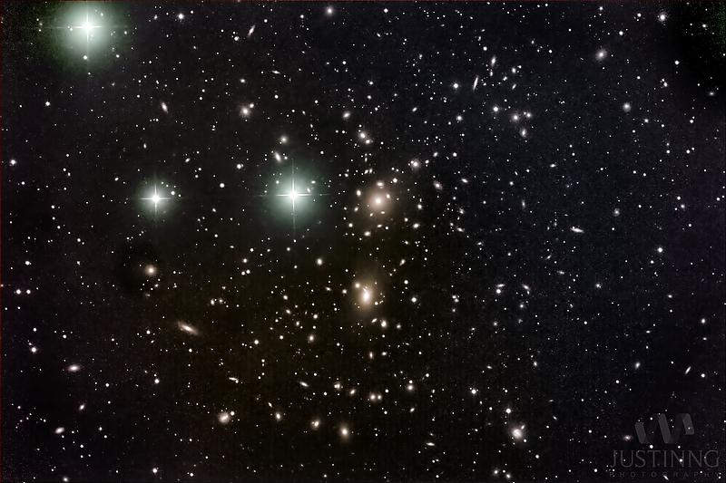
Analysis of Correlation between Conventional and Ultra Diffuse Galaxies
Ryan Webster
Advisor: Prof. Dennis Zaritsky
Credit: Justin Ng

Slide 2
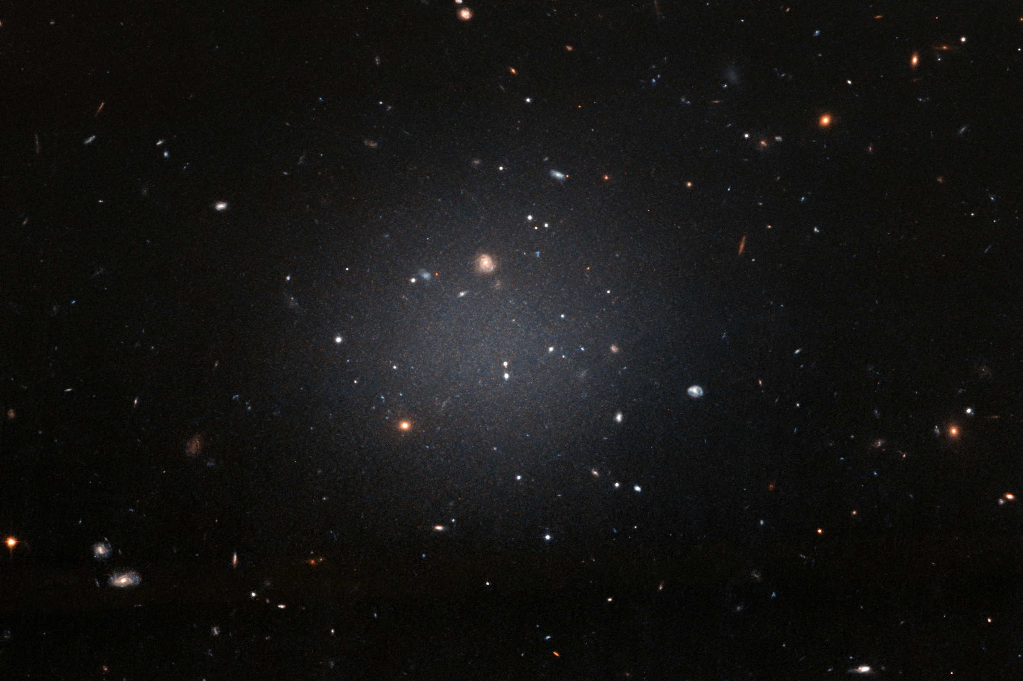
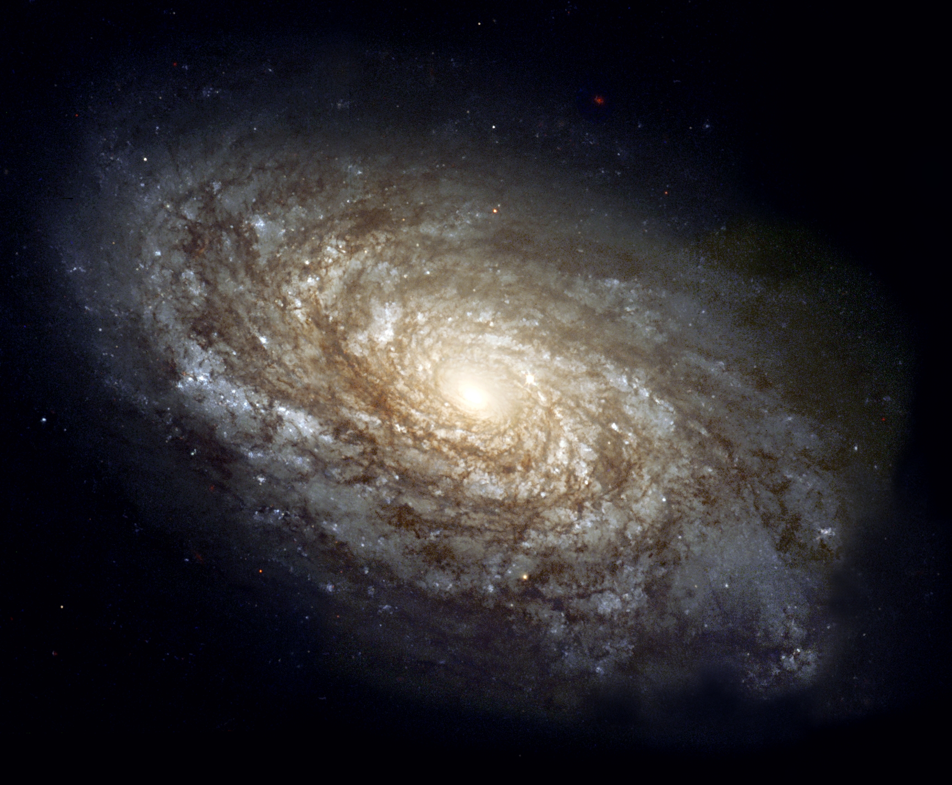
What are Ultra Diffuse Galaxies (UDGs)?
Exotic subclass of galaxy
Characterized by abnormally low surface brightnesses, but are the sizes of conventional galaxies
Goal: to explore how UDGs cluster with each other and normal galaxies
UDG
Normal Galaxy
Credit: ESA/Hubble
Credit: The Hubble Heritage Team

Slide 3
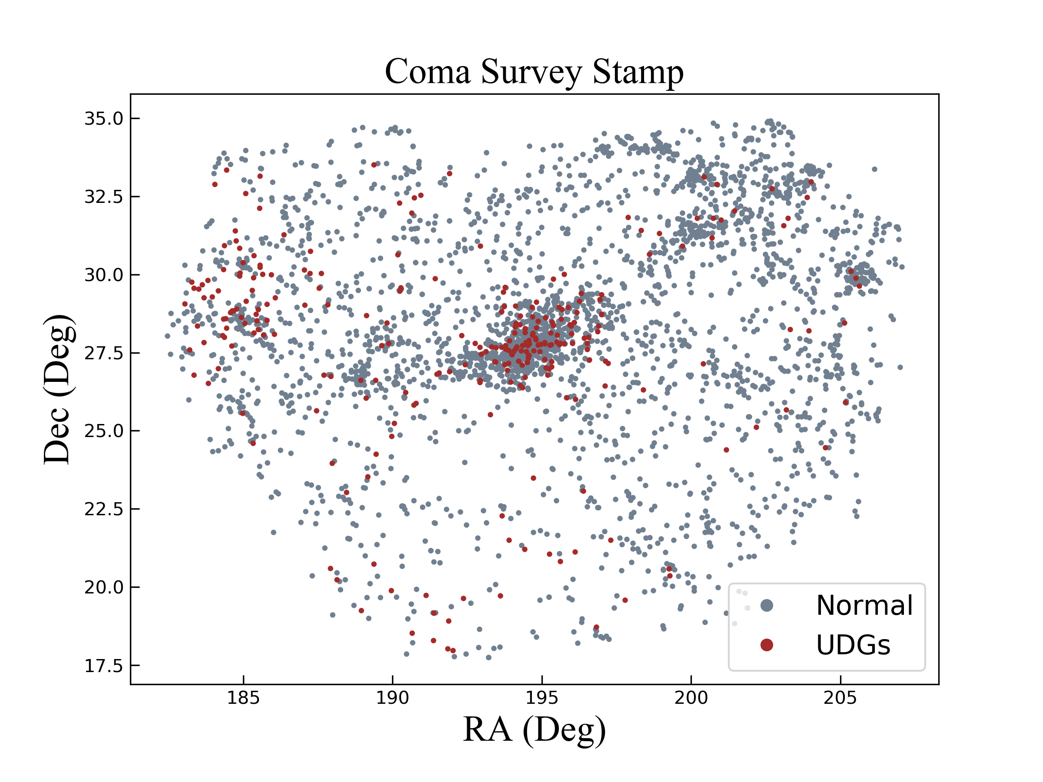
Our Survey
274 UDGs found in Coma with SMUDGes Survey (Zaritsky et al. 2019)
3372 normal galaxies in SMUDGes Survey stamp
Need 10⁵ randomized points for analysis (not pictured)

Slide 4
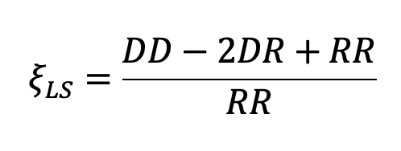
Correlation Functions
Defined as the excess probability (relative to a Poisson Distribution) of finding two galaxies with a certain volume at a separated distance “r”
Calculated with Landy-Szalay formula:
Where DD is correlation between the two catalogs, DR is normal galaxies and random points correlation, and RR is the random points auto-correlation

Slide 5
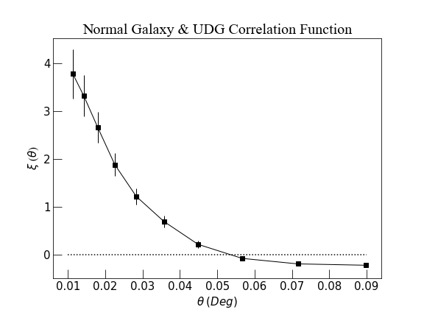
Coma Correlation Function
Min separation = 0.01 deg
Max separation = .1 deg
UDGs correlate with normal galaxies
~ 3.7x at small scales, decreases to 0 at large scales

Slide 6
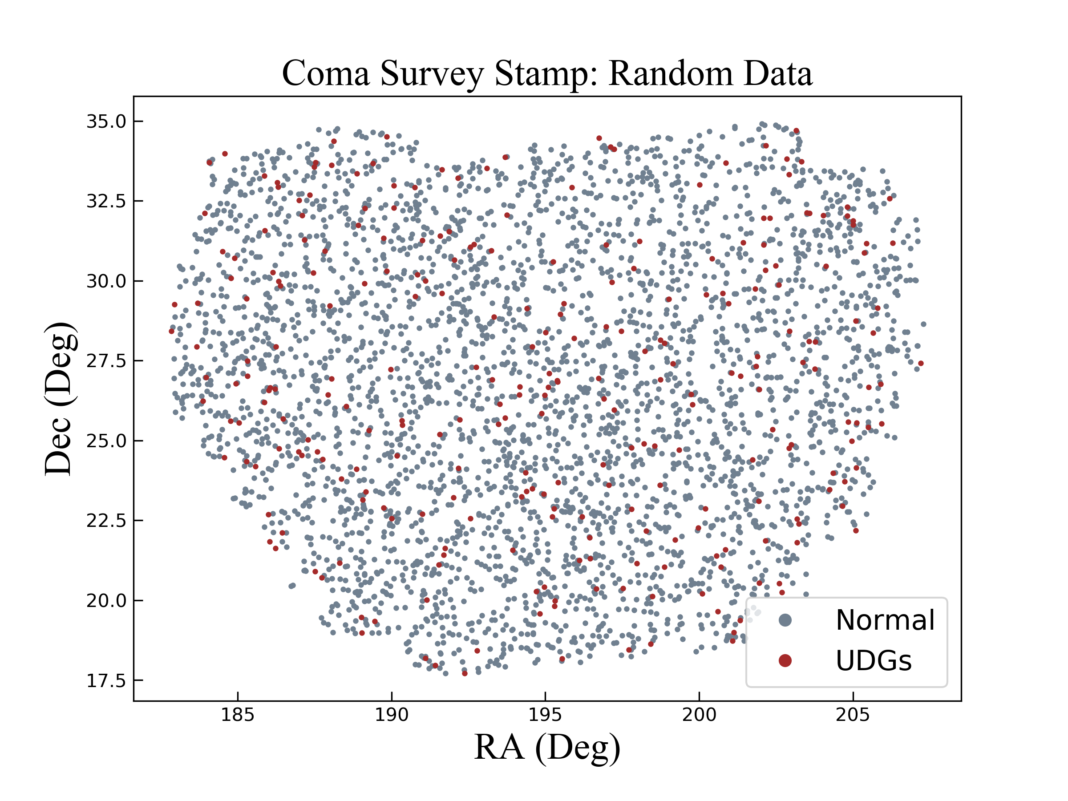
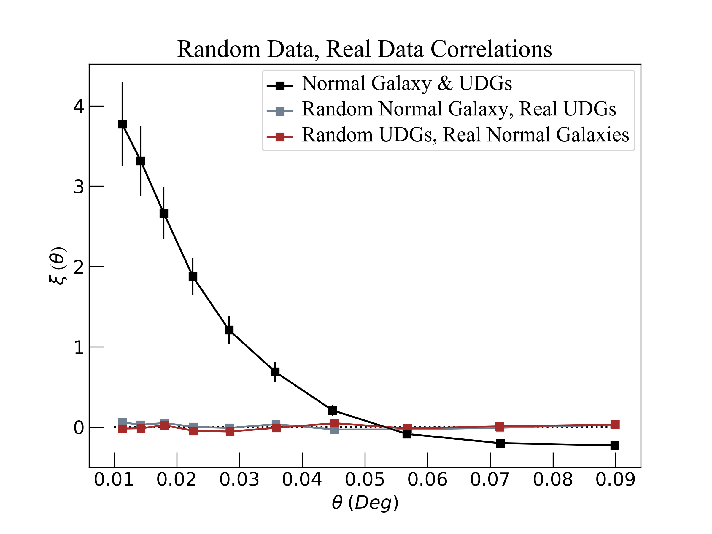
Testing Correlation Function
Generated randomized UDG and normal galaxy catalog

Slide 7
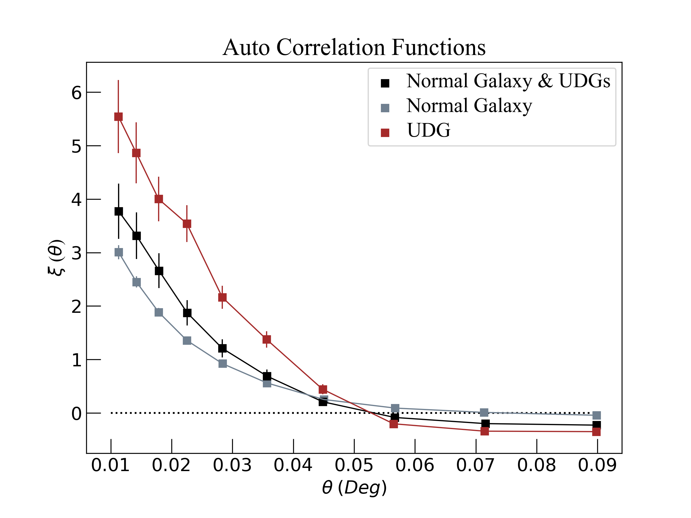
Autocorrelation Functions
Normal Galaxy/ UDG correlation similar to UDG and normal Galaxy autocorrelations
UDGs cluster more strongly with each other than with normal galaxies
Appear to prefer dense environments

Slide 8
Thank you!
Credit: Justin Ng

